Slide 2

Cloud Native
Notes:
Like every developer knows about agile, but there’re only few really can do it. Cloud Native seems easy, but it contains many of software technologies and operation overheads. To dealing with this truth, Pivotal offers Cloud Foundry for enterprise who wants to archive time-to-market.

Slide 3
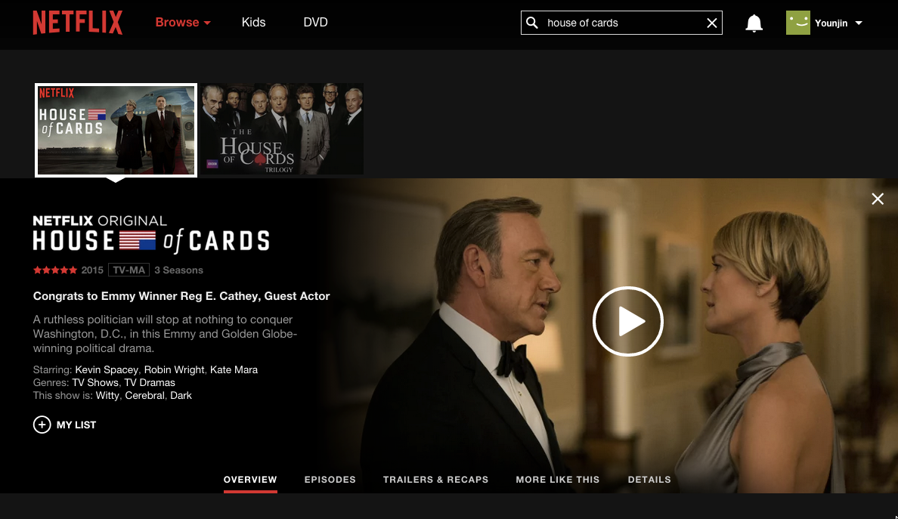

Slide 4
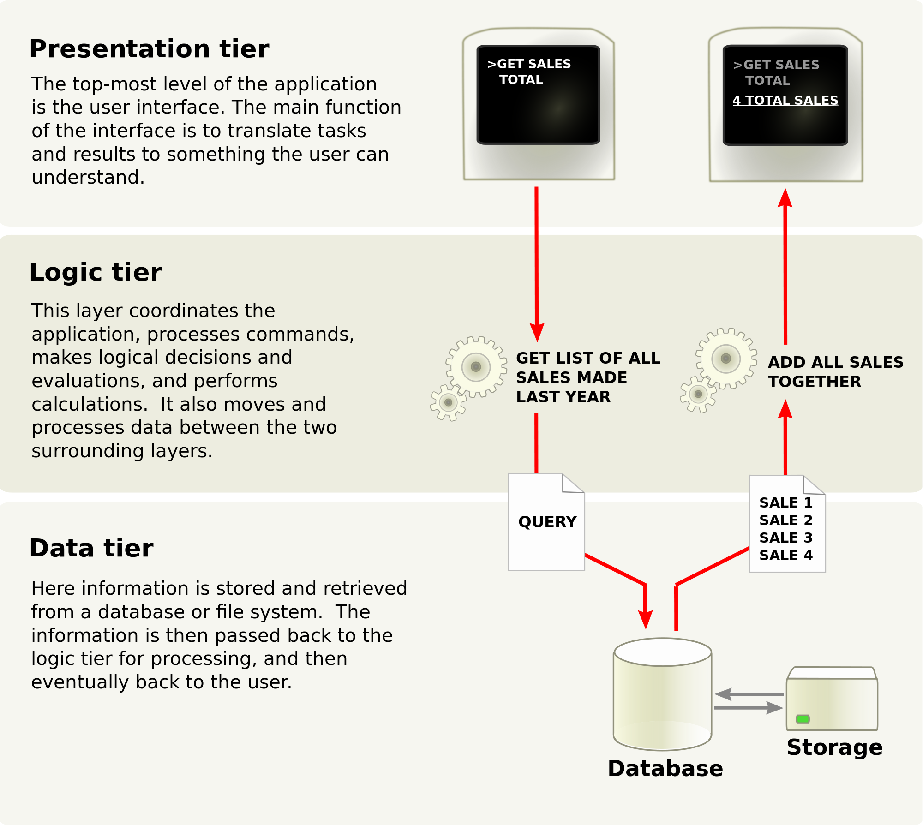

Before Cloud

Slide 5
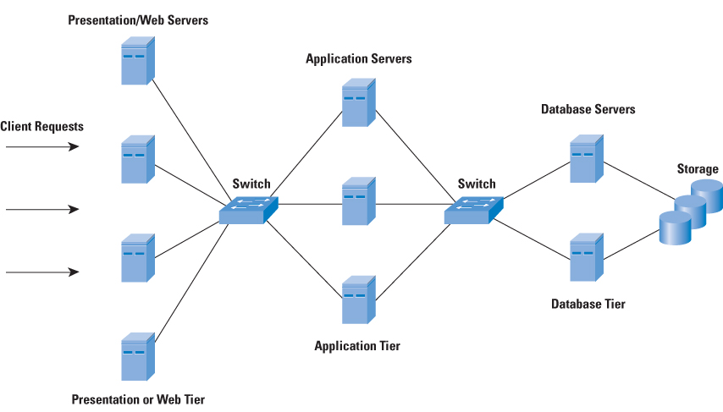
3-tier infrastructure architecture
Image source: http://www.cisco.com

Slide 6
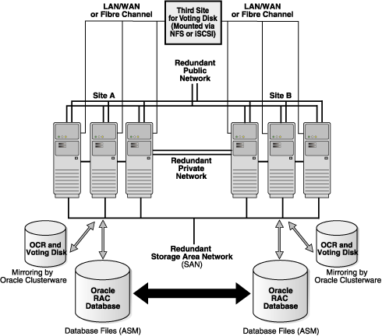

And most customers are using…

Slide 7
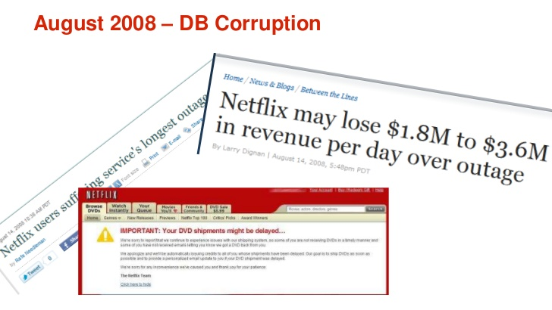
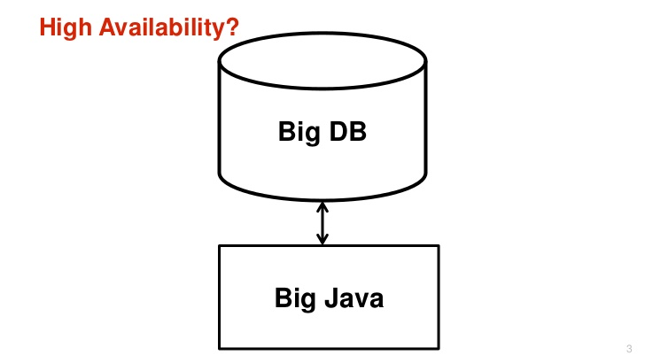
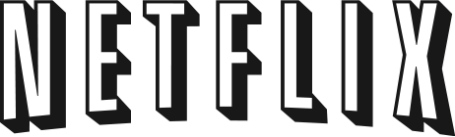
Netflix 2008
2008
http://www.slideshare.net/KevinMcEntee/netflix-incloudsmarch8-2011forwiki
Notes:
Monolithic perfectly make sense when you need to work base on 3 tier physical hardware. There was only scale-up, and to maintain complex database, was cluster, operators are necessary to archive 24x7x365 uptime. However, as number of users increased, and mobile explosion happened, this architecture does not work anymore. This was happened to Amazon.com in more early days, and this kind of huge failure drives them to move new ERA of service.

Slide 8
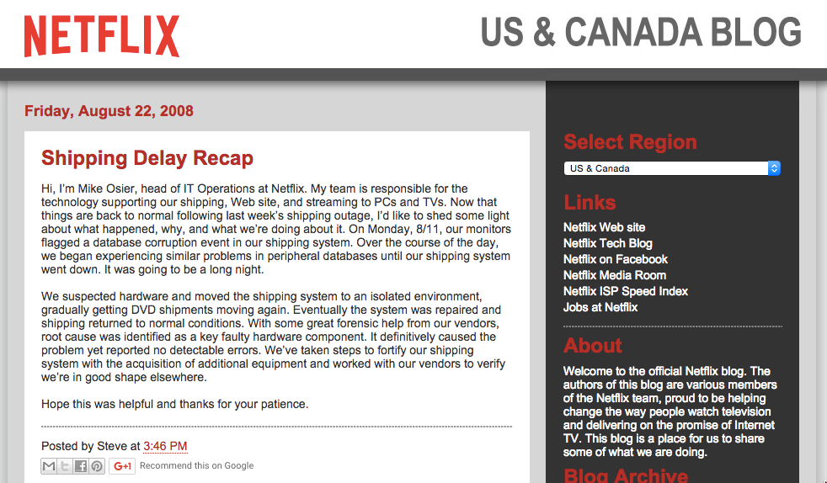
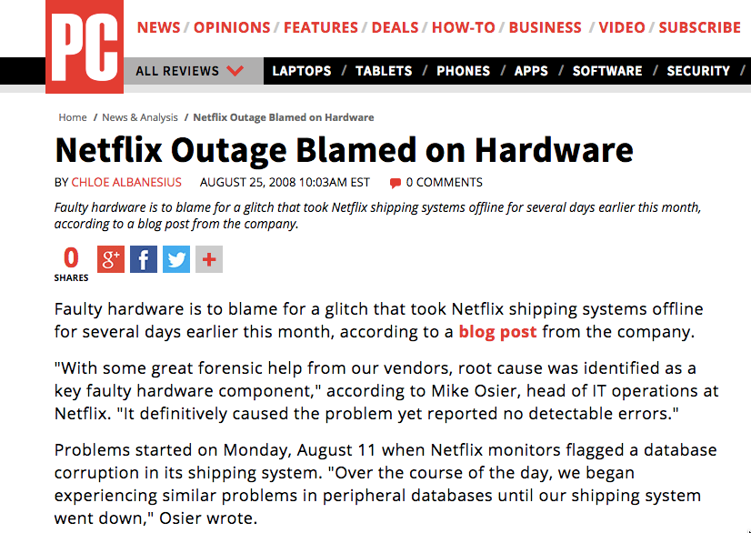
http://blog.netflix.com/2008/08/shipping-delay-recap.html http://www.pcmag.com/article2/0,2817,2328778,00.asp

Slide 9
“Big Failure”

Slide 10
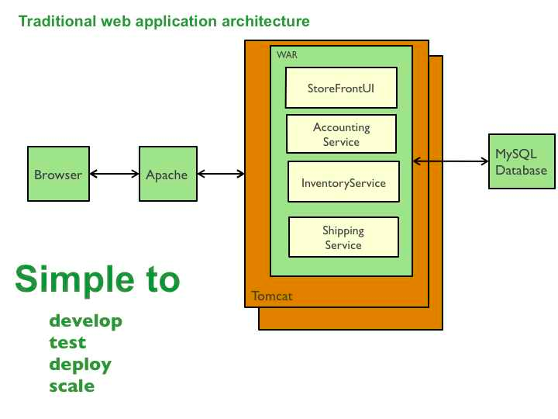
Cons of Monolithic architecture
Fault isolation
Fault tolerance
Distribution
Automated recovery
Scale
Resilience
Continuous Deploy
…
http://microservices.io/patterns/monolithic.html

Slide 11
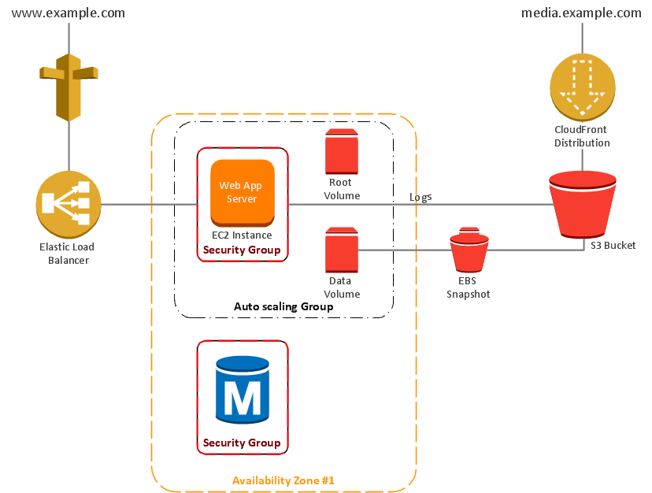
Cloud Era.
API

Slide 12
Micro services architecture
Balancer A
Balancer B
Balancer N
K/V Store
NoSQL
Login App
Search App
Billing App
RDBMS
Streaming App
DRM App
Metering App
Cache
Logging App
Recommendation Engine
….
MQ
Cloud Infrastructure

Slide 13
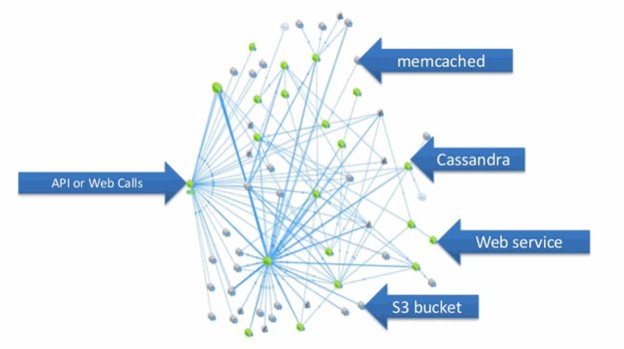
It looks like…
http://www.journaldunet.com/solutions/cloud-computing/coulisses-techniques-de-netflix/architecture-en-micro-services.shtml

Slide 14
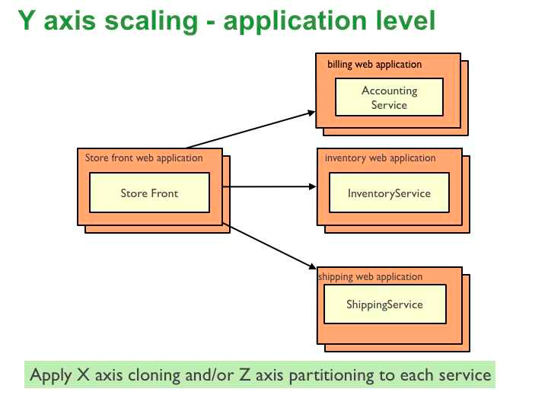
Fault isolation
Fault tolerance
Distribution
Automated recovery
Scale
Resilience
Continuous Deploy
…

Slide 15
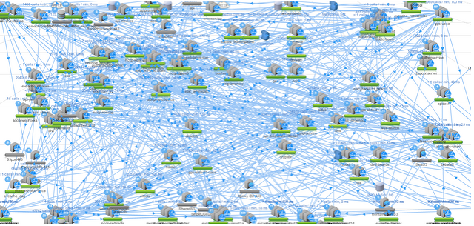
2015 - Micro Services Architecture
http://www.slideshare.net/stonse/microservices-at-netflix
Notes:
This is how Netflix looks like today. Each single box means micro service. One of them is only work for file upload, and one of them is only work for sign-on, etc. Every single micro services talking to another micro service to get information. And each micro services are fully monitored, and has auto recovery features. For your easy understand, each micro service has load balancers, web servers, workers, caches, and databases. This was impossible if you want to build this architecture with few high price-tagged super computing machines. And every single micro services can auto-sacled.
And it took 7 years. For Amazon, they started this even earlier than Netflix.

Slide 16
3 Lessons from Netflix on Cloud
Create micro-service
Build in redundancy
Be resilient
http://www.networkworld.com/article/2170675/cloud-computing/three-lessons-from-netflix-on-how-to-live-in-the-cloud.html

Slide 17
It’s not only about Netflix
Amazon
http://highscalability.com/blog/2007/9/18/amazon-architecture.html
eBay
http://www.addsimplicity.com/downloads/eBaySDForum2006-11-29.pdf
Netflix
http://techblog.netflix.com/

Slide 18
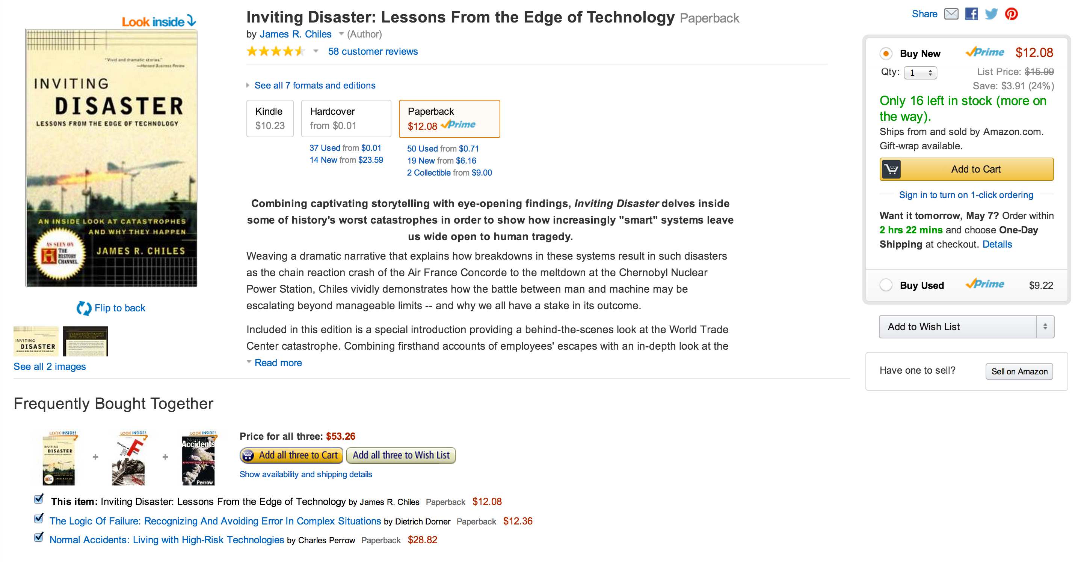

How many microservices?
ELEVEN

Slide 19
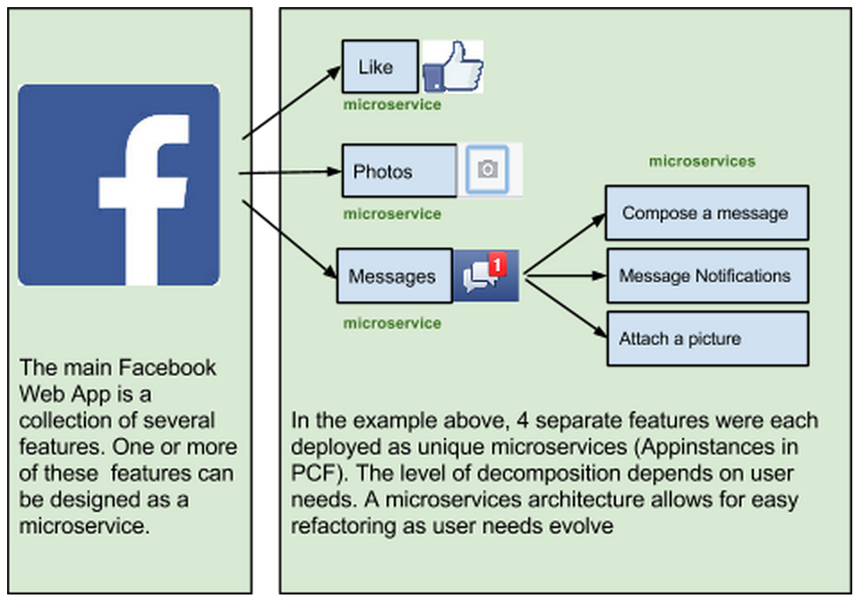

Slide 20
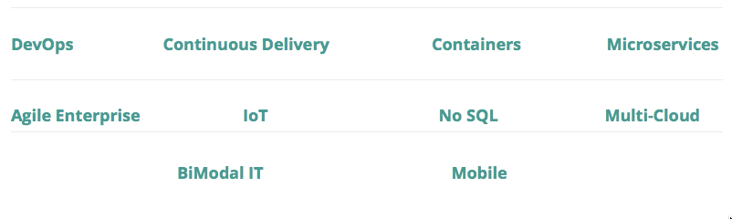
Cloud Native

Slide 21
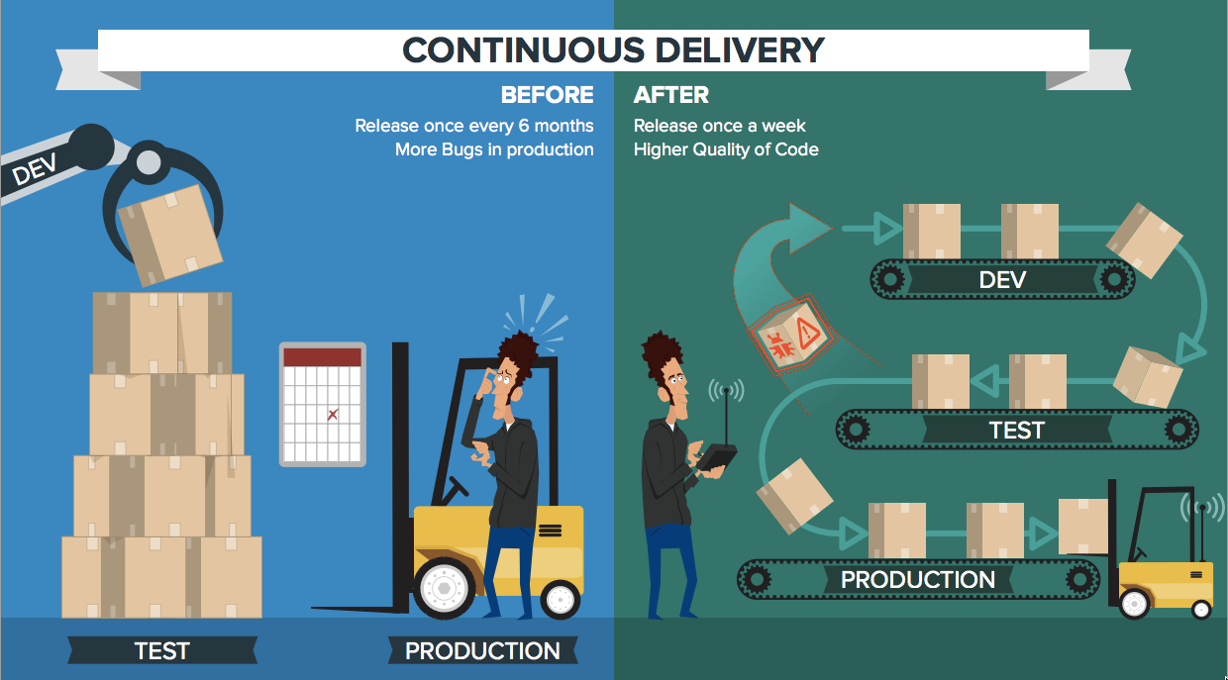

Slide 22
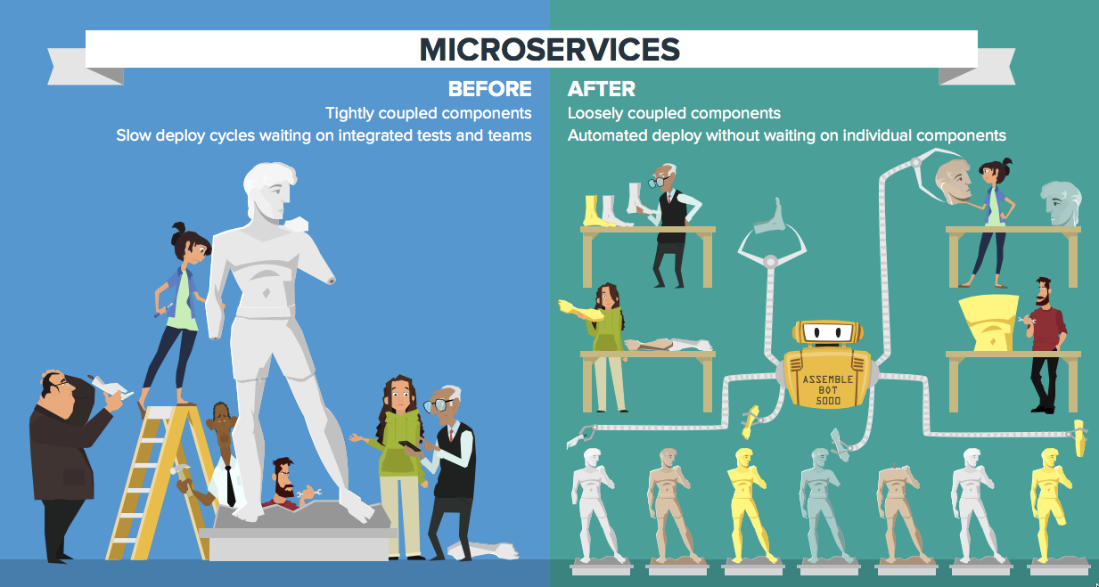

Slide 23
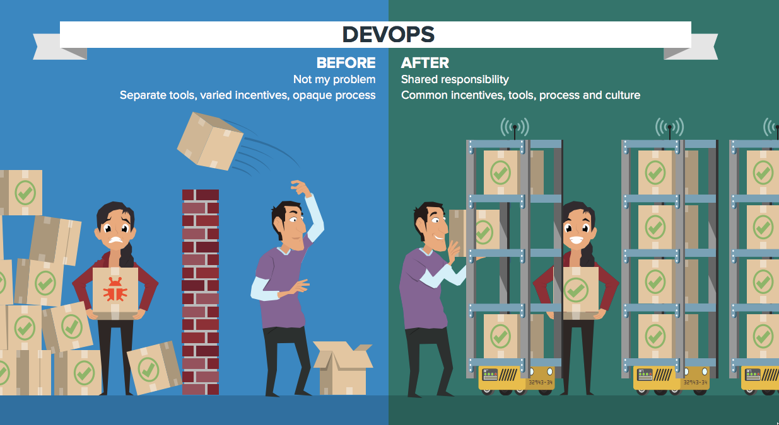

Slide 24
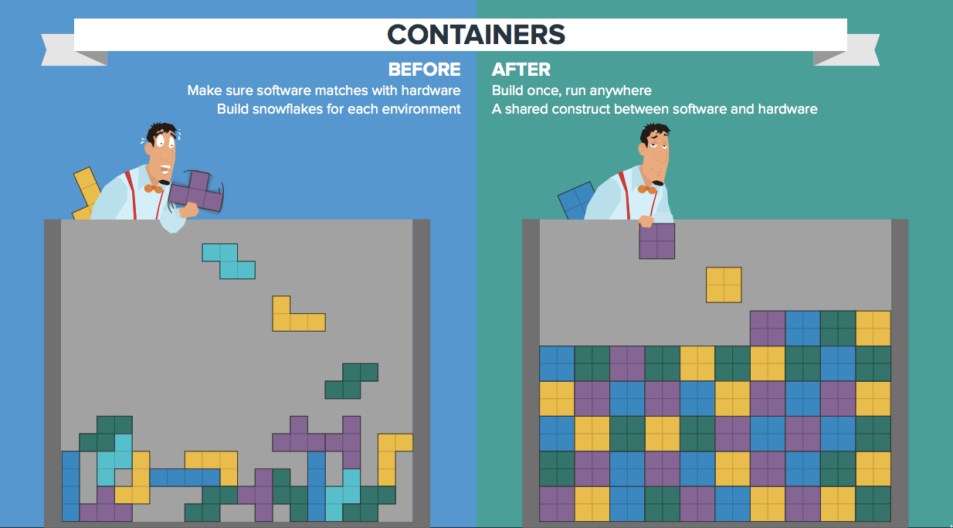

Slide 25
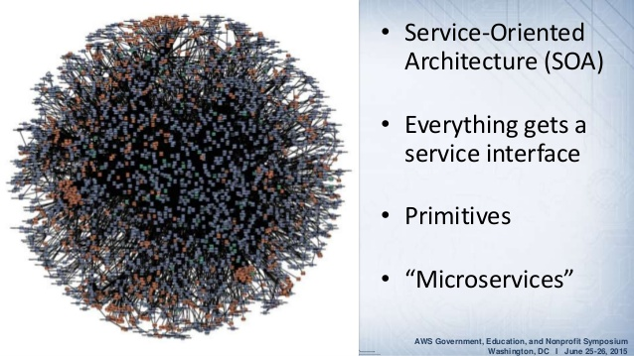
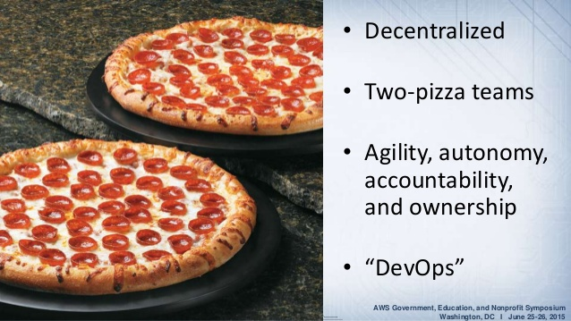
2 pizza team
http://www.slideshare.net/AmazonWebServices/aws-codedeploy-aws-codepipeline-and-aws-codecommit-transforming-software-development

Slide 26




CATALOG
INVENTORY
Prod Release
Prod Release
Prod Release
Prod Release
Prod Release
Prod Release
REVIEWS
SHIPPING
Prod Release
Prod Release
Prod Release
Prod Release
Prod Release
Prod Release

Slide 27
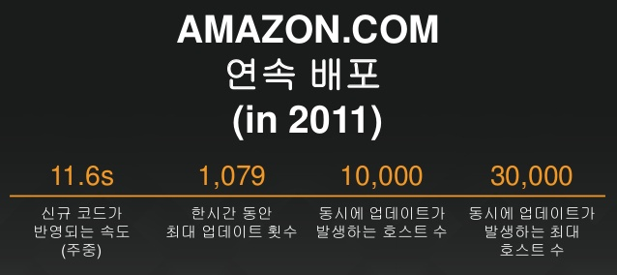
http://www.slideshare.net/awskorea/aws-summit-seoul-2015-aws-47454649

Slide 28
어플리케이션의 배포 속도는 곧 비지니스 개선 속도
Amazon.com 은 1시간에 1천번

Slide 29
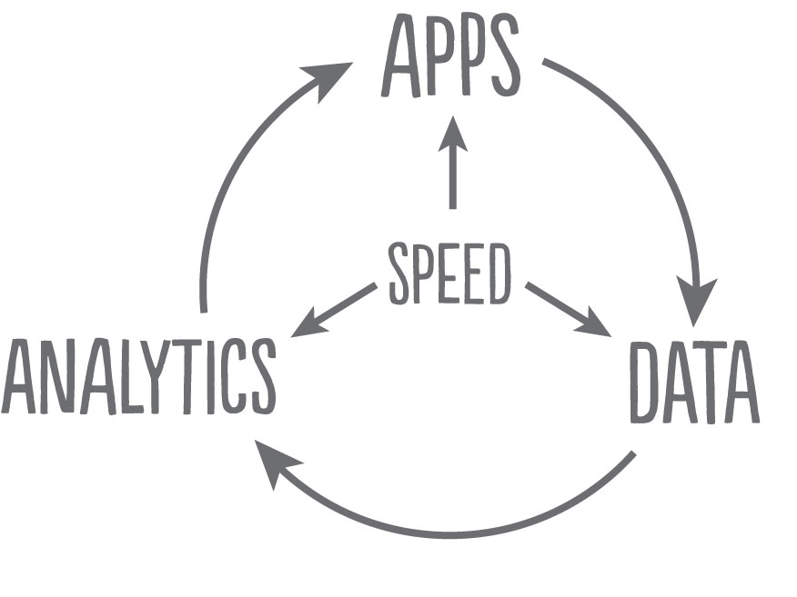

Slide 30
Cloud Native Journey
Greenfiled Development
Legacy Management
IT Transformation

Slide 31
시장을 선도하는 서비스들의 특징
다운타임이 Zero 에 가까움
서비스에 업데이트가 초단위로 발생
대규모 분산 구조
원하는 글로벌 지역에 즉시 사업 개시 가능한 신속성
엄청난 수의 사용자의 유입을 처리 가능
매우 뛰어난 웹 / 모바일 어플리케이션 품질
비지니스 자체에 집중

Slide 32
12 Factor Apps
Notes:
Like every developer knows about agile, but there’re only few really can do it. Cloud Native seems easy, but it contains many of software technologies and operation overheads. To dealing with this truth, Pivotal offers Cloud Foundry for enterprise who wants to archive time-to-market.

Slide 33
The Twelve Factors
Codebase
Dependencies
Config
Backing Services
Build, release, run
Processes
Port binding
Concurrency
Disposability
Dev/prod parity
Logs
Admin processes
http://12factor.net/

Slide 34
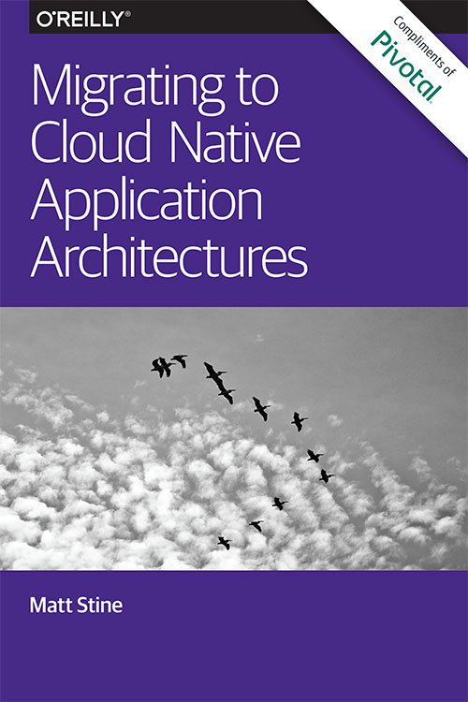
무료로 배포
마음껏 읽어보세요.
한글판은 준비중 ☺
http://pivotal.io/platform/migrating-to-cloud-native-application-architectures-ebook

Slide 35
Netflix OSS
Notes:
Like every developer knows about agile, but there’re only few really can do it. Cloud Native seems easy, but it contains many of software technologies and operation overheads. To dealing with this truth, Pivotal offers Cloud Foundry for enterprise who wants to archive time-to-market.

Slide 36
7 years for Cloud Native (2008 – 2015)
Big Java
API
Routing / Health check
Micro Services
Logging
Big Oracle
Data
Cloud IaaS
Notes:
What they’re trying last 7 years is, transforming their service to “Cloud Native” which is including DevOps, Micro Services architecture, and Data driven based on Cloud. By having this transformation, they could archive almost zero downtime service on cloud.

Slide 37
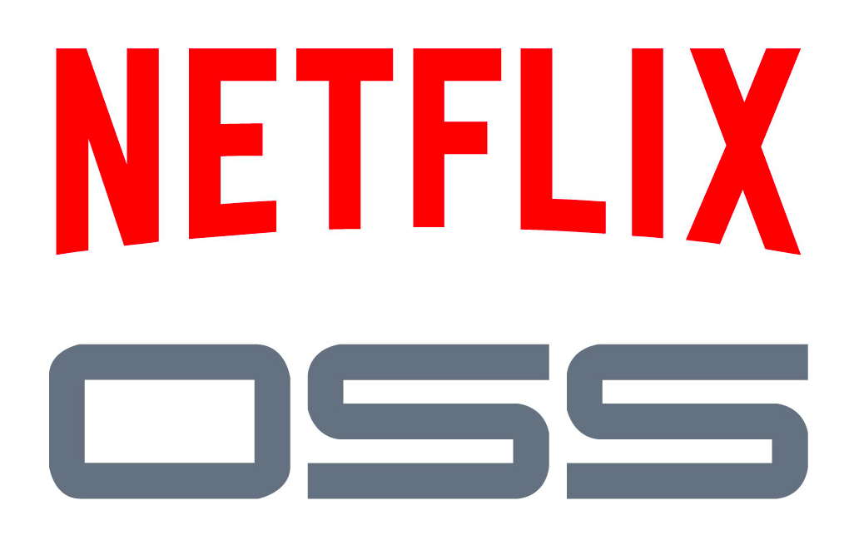
Netflix experiences – Netflix OSS
API
Routing / Health check
Micro Services
Logging
Data
Cloud IaaS
http://netflix.github.io/

Slide 38
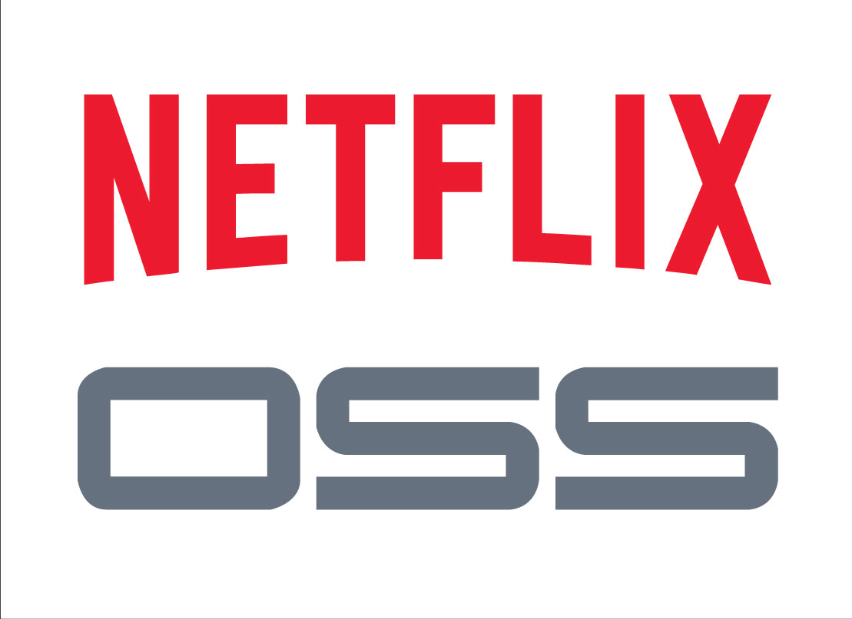
Eureka
Hystrix + Turbine
Ribbon
Feign
Zuul
http://netflix.github.io
Notes:
service registration (e.g.: Eureka, Consul, or Zookeeper)
Hystrix – circuit breaker Turbine – stream aggregation for hystrix metrics dashboards
Client SideLoad Balancer: Ribbon – which is hystrix aware so it knows where not to route to – smart endpoints, dumb pipes
Declarative REST clients (Netflix's Feign) – Edge clients on static DNS, edge services make calls to eureka / zuul to resolve to mod tier services
Router and Filter: automatic registration of Zuul filters, and a simple convention over configuration approach to reverse proxy creation
Service Discovery: Eureka instances can be registered and clients can discover the instances using Spring-managed beans
Service Discovery: an embedded Eureka server can be created with declarative Java configuration
Circuit Breaker: Hystrix clients can be built with a simple annotation-driven method decorator
Circuit Breaker: embedded Hystrix dashboard with declarative Java configuration
Declarative REST Client: Feign creates a dynamic implementation of an interface decorated with JAX-RS or Spring MVC annotations
External Configuration: a bridge from the Spring Environment to Archaius (enables native configuration of Netflix components using Spring Boot conventions)

Slide 39
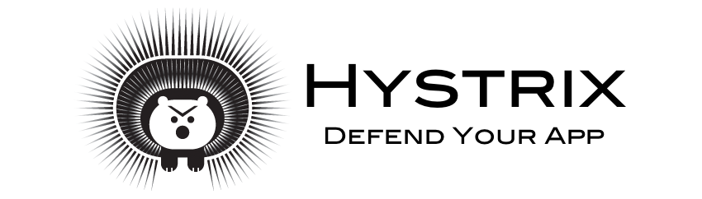
Netflix OSS - Hystrix
Hystrix: Latency and Fault Tolerance for Distributed Systems

Slide 40
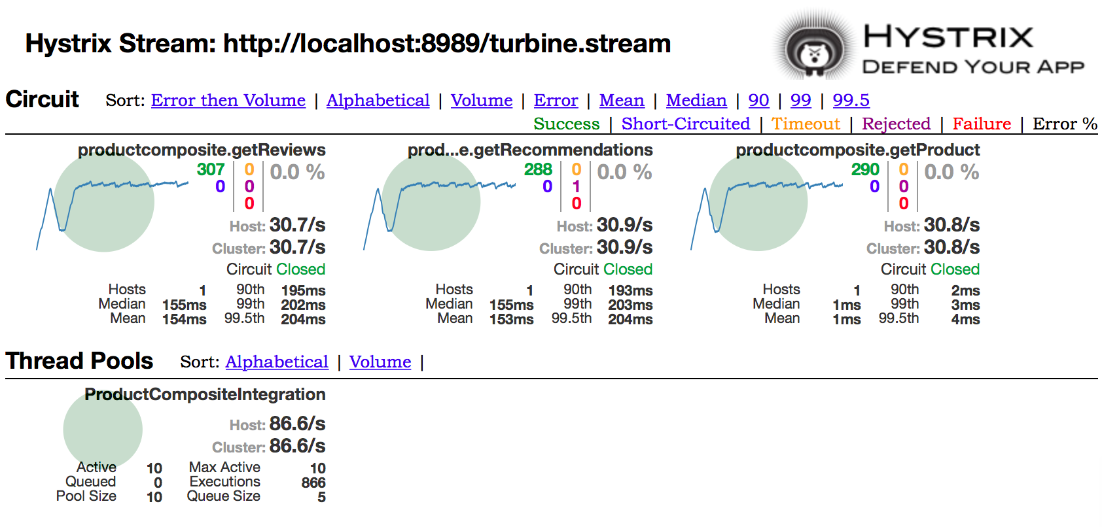

Slide 41
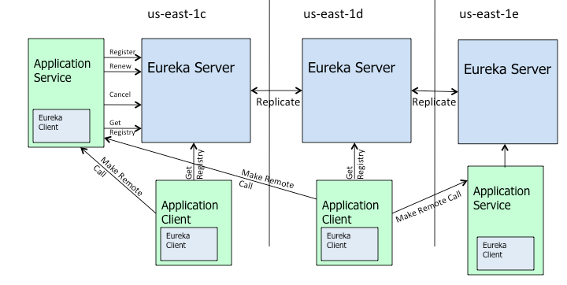
Netflix OSS – Eureka
Cloud Load Balancing And Failover Tool: Eureka!
Service Discovery

Slide 42
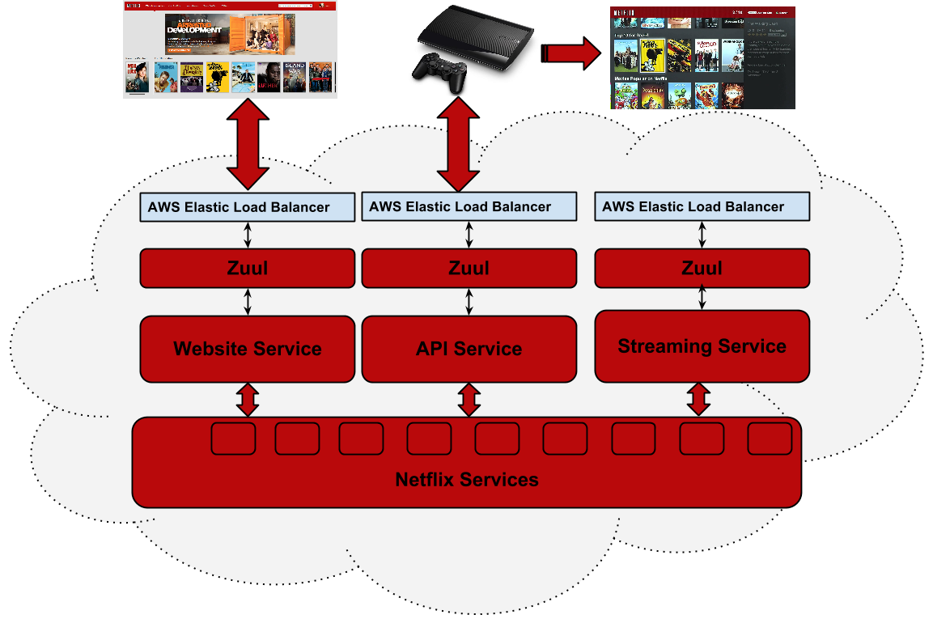
Netflix OSS – Zuul
Intelligent Routing
http://nirmata.com/2014/08/getting-started-with-microservices-using-netflix-oss-docker/

Slide 43

Netflix OSS – Ribbon
Ribbon is a client side IPC library that is battle-tested in cloud. It provides the following features
Load balancing
Fault tolerance
Multiple protocol (HTTP, TCP, UDP) support in an asynchronous and reactive model
Caching and batching

Slide 44

Netflix OSS links
Hystrix : https://github.com/Netflix/Hystrix
Zuul : https://github.com/Netflix/zuul
Ribbon : https://github.com/Netflix/ribbon
Eureka : https://github.com/Netflix/eureka
Netflix OSS : https://netflix.github.io/

Slide 45
Spring framework
Notes:
Like every developer knows about agile, but there’re only few really can do it. Cloud Native seems easy, but it contains many of software technologies and operation overheads. To dealing with this truth, Pivotal offers Cloud Foundry for enterprise who wants to archive time-to-market.

Slide 46
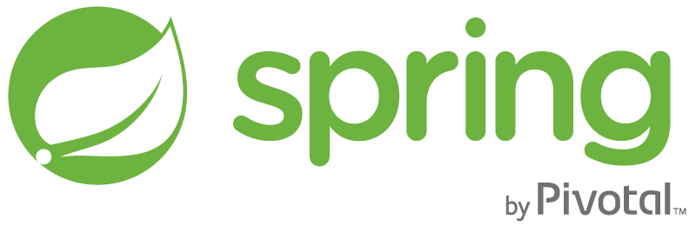
http://spring.io
Notes:
We owns spring. If you access to http://spring.io, then you will see our corporate logo at bottom.

Slide 47
Notes:
Netflix is one of our customer, and they’re publishing OSS which contains their 7 year experiences. Their OSS contains super powerfull developer tools to archive Cloud Native, so we worked to adopt their experiences to Spring framework.

Slide 48
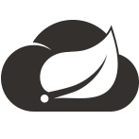
Spring Cloud
Distributed/versioned configuration
Service registration and discovery
Routing
Service-to-service calls
Load balancing
Circuit Breakers
Global locks
Leadership election and cluster state
Distributed messaging
http://cloud.spring.io/spring-cloud-netflix/spring-cloud-netflix.html
Notes:
That is called as “Spring Cloud”.

Slide 49
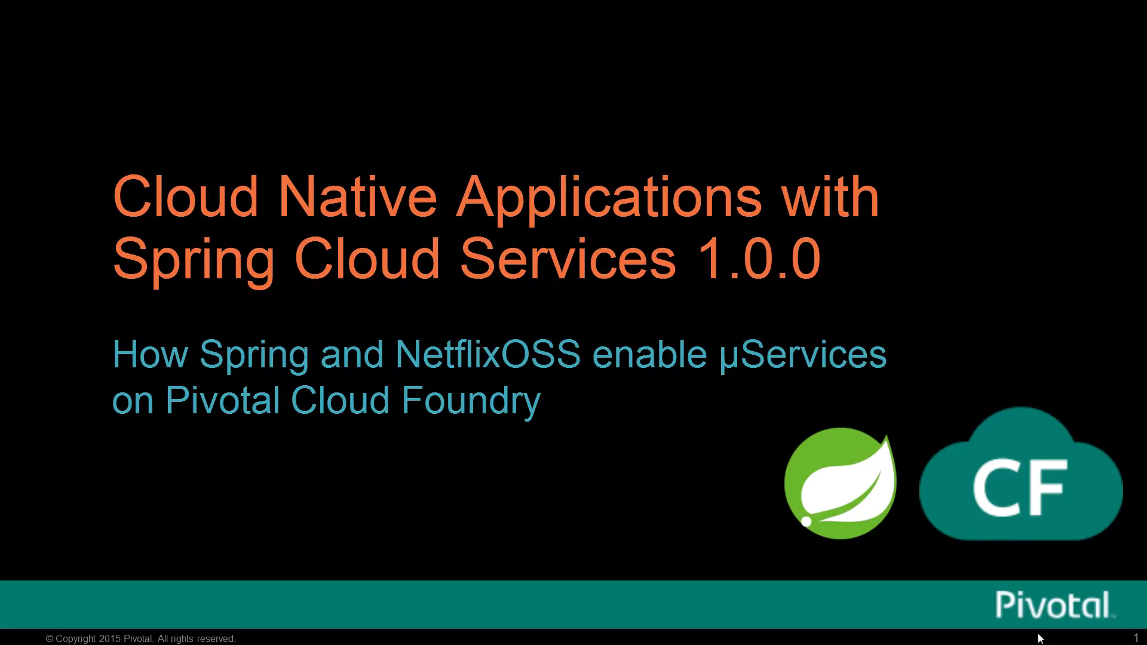

Slide 50

General Introduction
Notes:
Like every developer knows about agile, but there’re only few really can do it. Cloud Native seems easy, but it contains many of software technologies and operation overheads. To dealing with this truth, Pivotal offers Cloud Foundry for enterprise who wants to archive time-to-market.

Slide 51
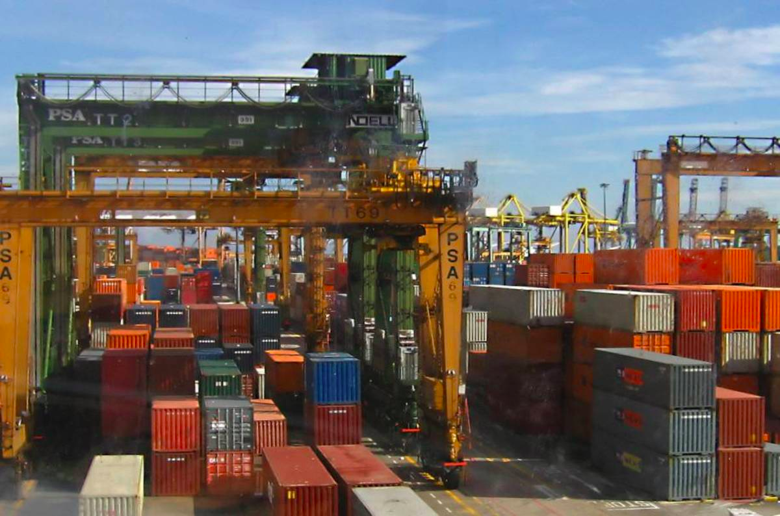

Slide 52

It is
not
EASY

Slide 53
Container only
Dynamic Routing
Scheduling
Log aggregation / Status Stream
Health monitoring / Self Healing
Upgrade / Patch
…
HOW?

Slide 54

To: Pushing apps to the cloud with a few easy verbs
Operator
Developer
cf-iaas.yml
provision <my cloud>
add_capacity <my cloud>
target <my cloud>
push <my app>
create <my services>
bind <my services>
scale <my app> +100
Cloud Deployment: 2-4 hours
App Deployment: 30-90 seconds

Slide 55

Overview: Deploying App to Cloud Foundry Runtime
Developer
Blobstore
Service
credentials
Upload app bits and metadata
DB
push app
+ app MD
Cloud Controller
Service Broker Node(s)
Create and bind services
Stage application
Deploy application
Manage application health
Router
DEA
DEA
DEA
DEA
+
=
Cloud Foundry
Runtime (PaaS)
…which we will depict in a moment
Notes:
Cloud Foundry PaaS
An application runs in a DEA, which is a droplet execution agent. The Cloud Controller orchestrates the routing and lifecycle of all DEAs in the pool. Routers manage application traffic. Health Manager reports mismatched application states to the CC. A service gateway provides an interface for services (native or external). A messaging bus manages all system communication. Apps are accessed directly through the router while web and CLI clients (e.g., vmc, STS) access Cloud Controller via RESTful services.

Slide 56
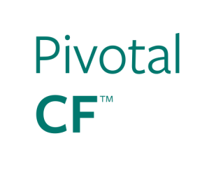
From a VM Centric to Application Centric World
App1
App2
Common Access Tier (App1, App2)
Configurations
Configurations
Built-in Middleware Services
Pre-Provisioned Pool of VMs
JVM
JVM
Container 1
Container 2
JVM
JVM
App Server
App Server
App Server
App Server
VM
VM
Infrastructure Specific
IaaS Agnostic

Slide 57
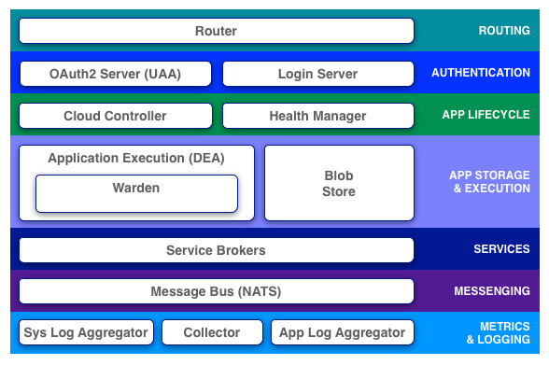
Cloud Foundry Architecture
Notes:
Cloud Foundry PaaS
An application runs in a DEA, which is a droplet execution agent. The Cloud Controller orchestrates the routing and lifecycle of all DEAs in the pool. Routers manage application traffic. Health Manager reports mismatched application states to the CC. A service gateway provides an interface for services (native or external). A messaging bus manages all system communication. Apps are accessed directly through the router while web and CLI clients (e.g., vmc, STS) access Cloud Controller via RESTful services.

Slide 58

Platform Runtime
Services
Routing
Service Discovery
Container Scheduling
Configuration
Database
Application Framework
Big Data
12 Factor Apps
Microservices
RESTful Services
Circuit Breakers
Object Storage
Mobile
Spring Boot
Ruby on Rails
Node.js
.NET
Continuous Integration
Logging & Metrics
Messaging
User Provided
Operations
Zero Downtime Deployments
Failover & Recovery
Scaling
Security Patching
Platform
Upgrades
Infrastructure
VMware
OpenStack
Amazon
Notes:
When if you want to build micro service based architecture, and trying to implement it to your own service, it’s really not easy to archive. You need to learn a lots of information and technologies such as CSP’s SDK for each service offers, need to learn how to aggregate logs, integrate with databases, caches, multi-vendor-versioned mobile supports, etc. I can sure that this will drive you to hell.
Cloud Foundry, is a platform that makes you focus only for code. If you are a Spring developer? Then just right code with Spring Cloud, and if you need database, just call an API then the database will be their with endpoint information which can be referenced by environment variables. You need cache? It’s all the same. If you need to deploy same code to AWS as OpenStack? Just change CF endpoint and push your code.

Slide 59
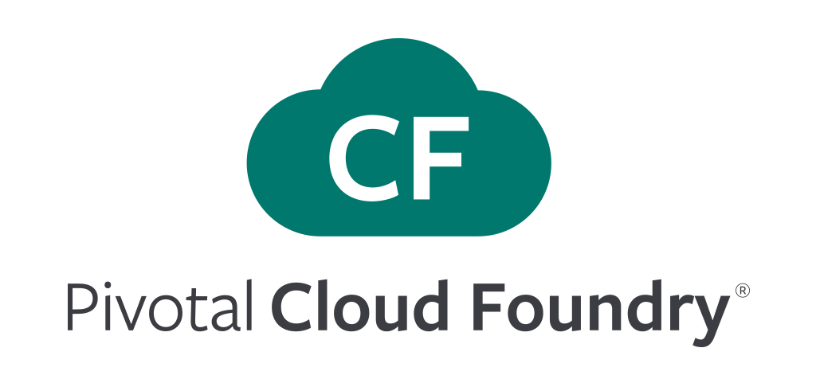
Application
Framework
Runtime
Platform
Infrastructure Automation
Notes:
We, Pivotal offers from framework to infrastructure automations.

Slide 60

Multi-Cloud
Your Applications
Lock-in
Cloud Foundry
Vendor A
PaaS
Cloud Foundry Foundation – non-for-profit 501©6 Linux Foundation Collaborative Project
Vendor A
IaaS
VMware
OpenStack
vCloud air
AWS
Azure
Google
Compute Engine
Now supported
Now supported
Future roadmap
On-premise
Public Cloud
Notes:
Multi-cloud support is super important to Enterprise. If you chose one, then it means you’ll be locked into them in code level. What if you want to deploy your code where AWS does not have regions? What if you want to don’t waste your time to rebuild code to migrate from OpenStack to AWS? As you already know, Spring is open sourced, it can be run anywhere. So there’s no code level lock-in. And Cloud Foundry helps to you keep away from complex multi-cloud implementation.
What if you chose one? I’d recommend you who’s behind on their product. Cloud Foundry, which is adopted by HP and IBM for their own version, is get supported by more than 24 vendors and it’s becoming a standard platform.

Slide 61
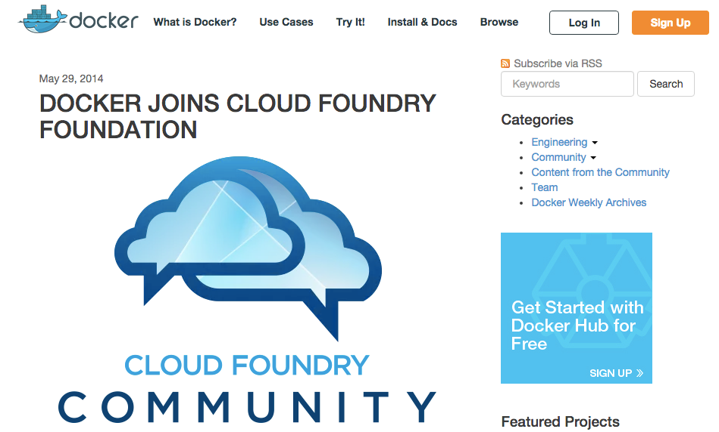
Containers - Docker?
We should make it clear that while we are supporting the Cloud Foundry foundation, we do not endorse any particular PaaS solution over others. We are excited by the broad range of solutions that have already incorporated native Docker support, both some established platforms and some that are purpose-built for Docker.
https://blog.docker.com/2014/05/docker-joins-cloud-foundry-foundation/

Slide 62
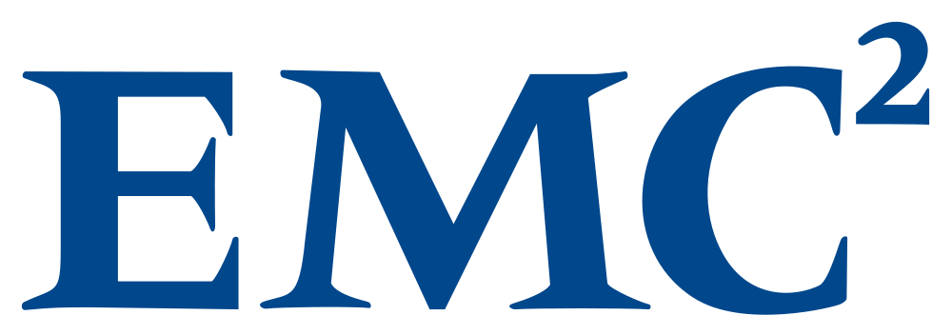
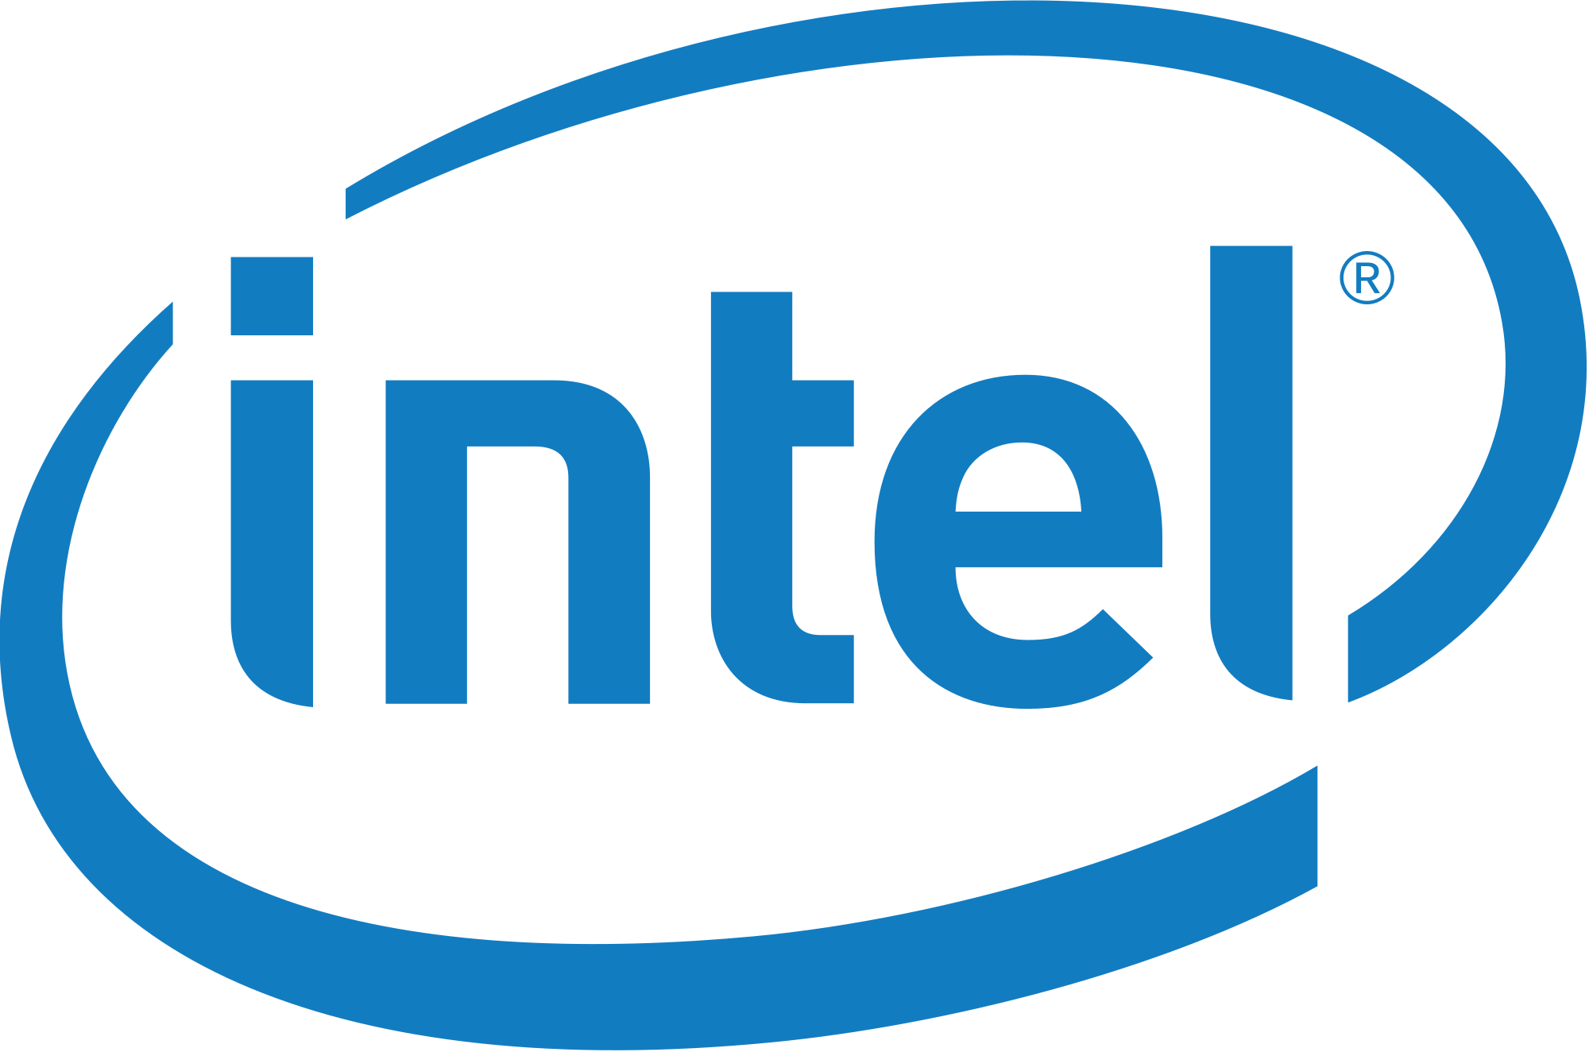
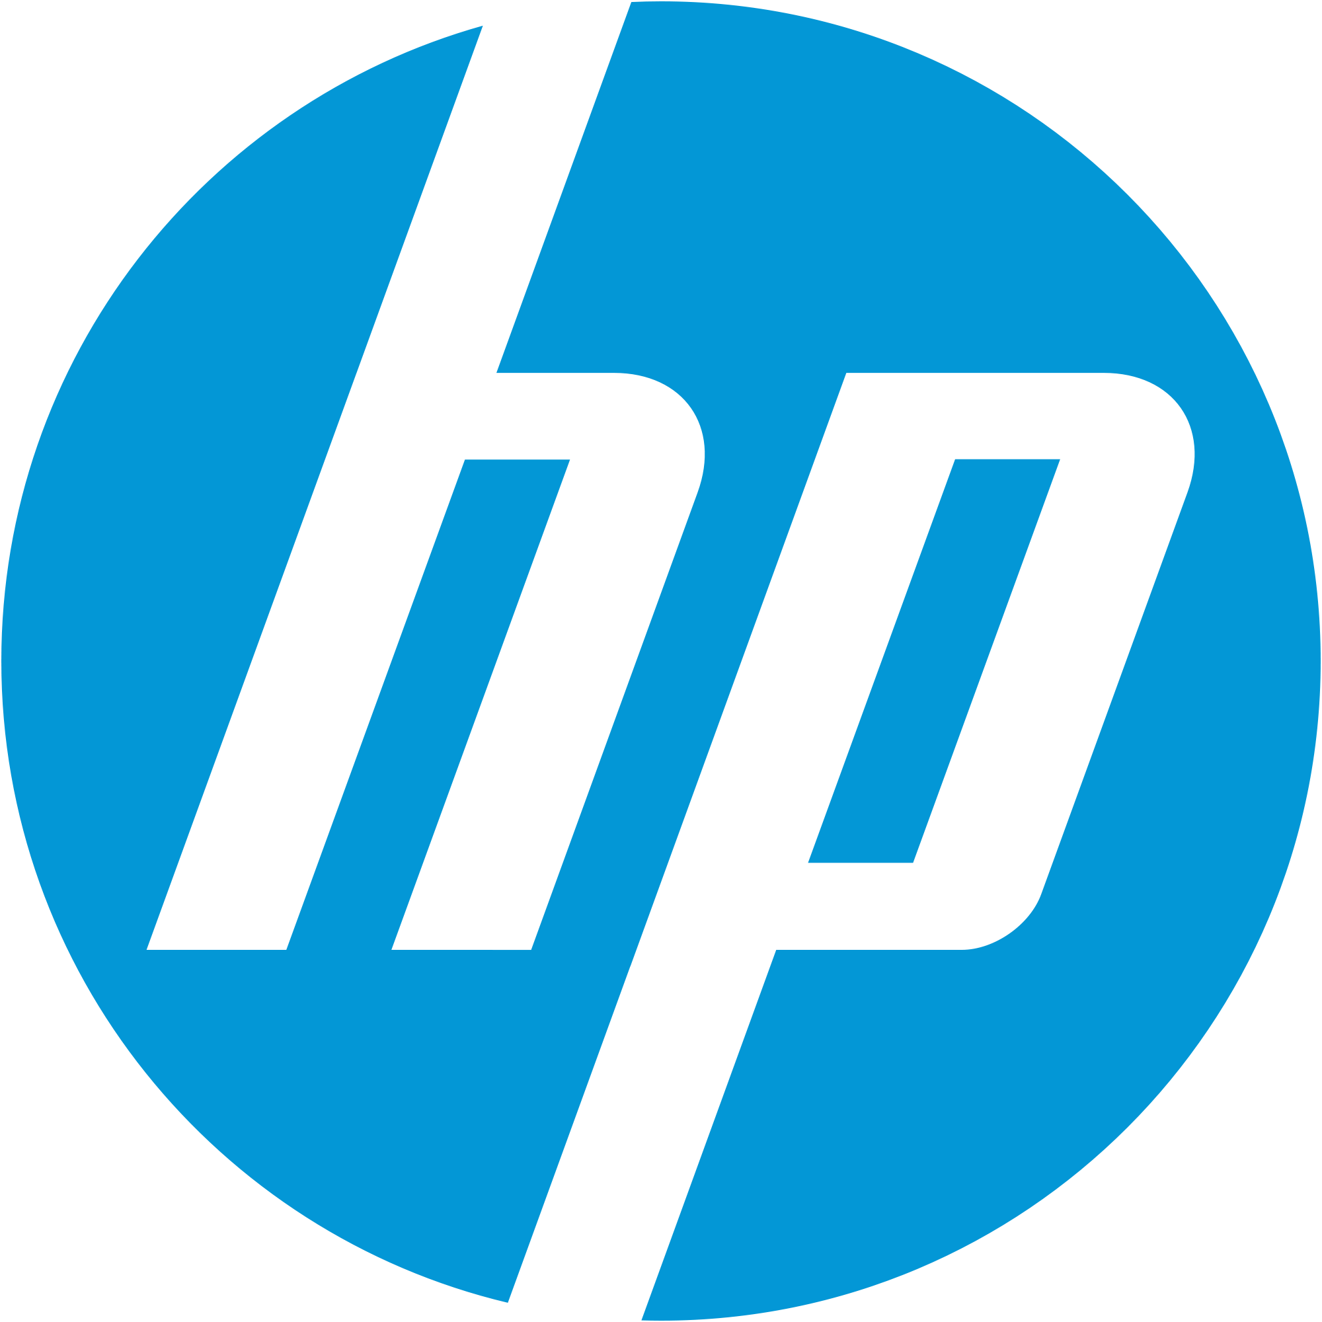
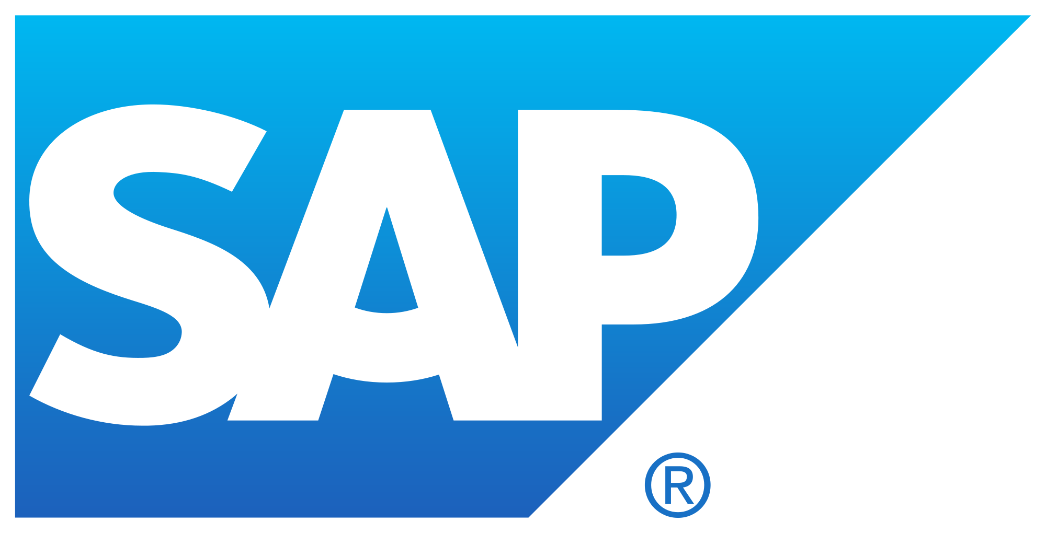
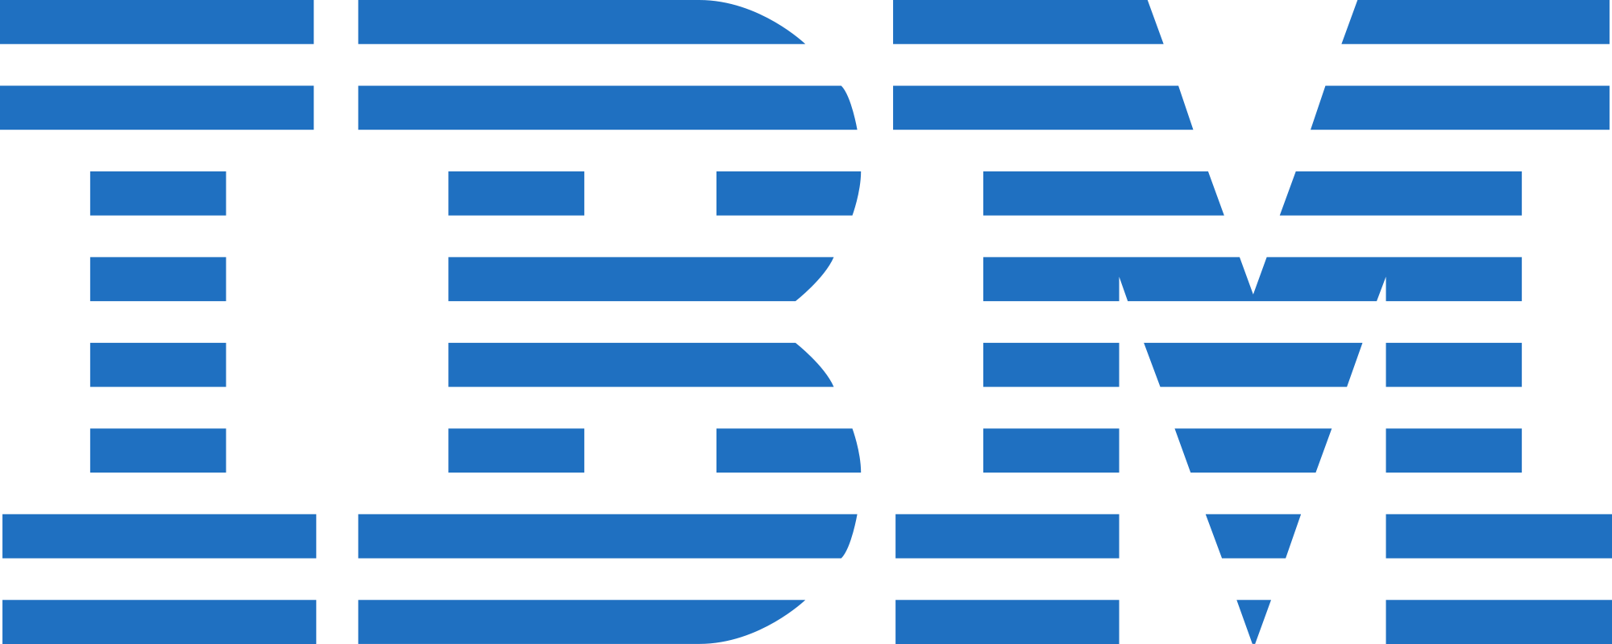
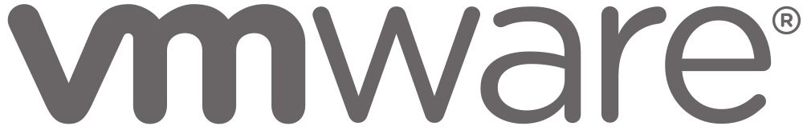
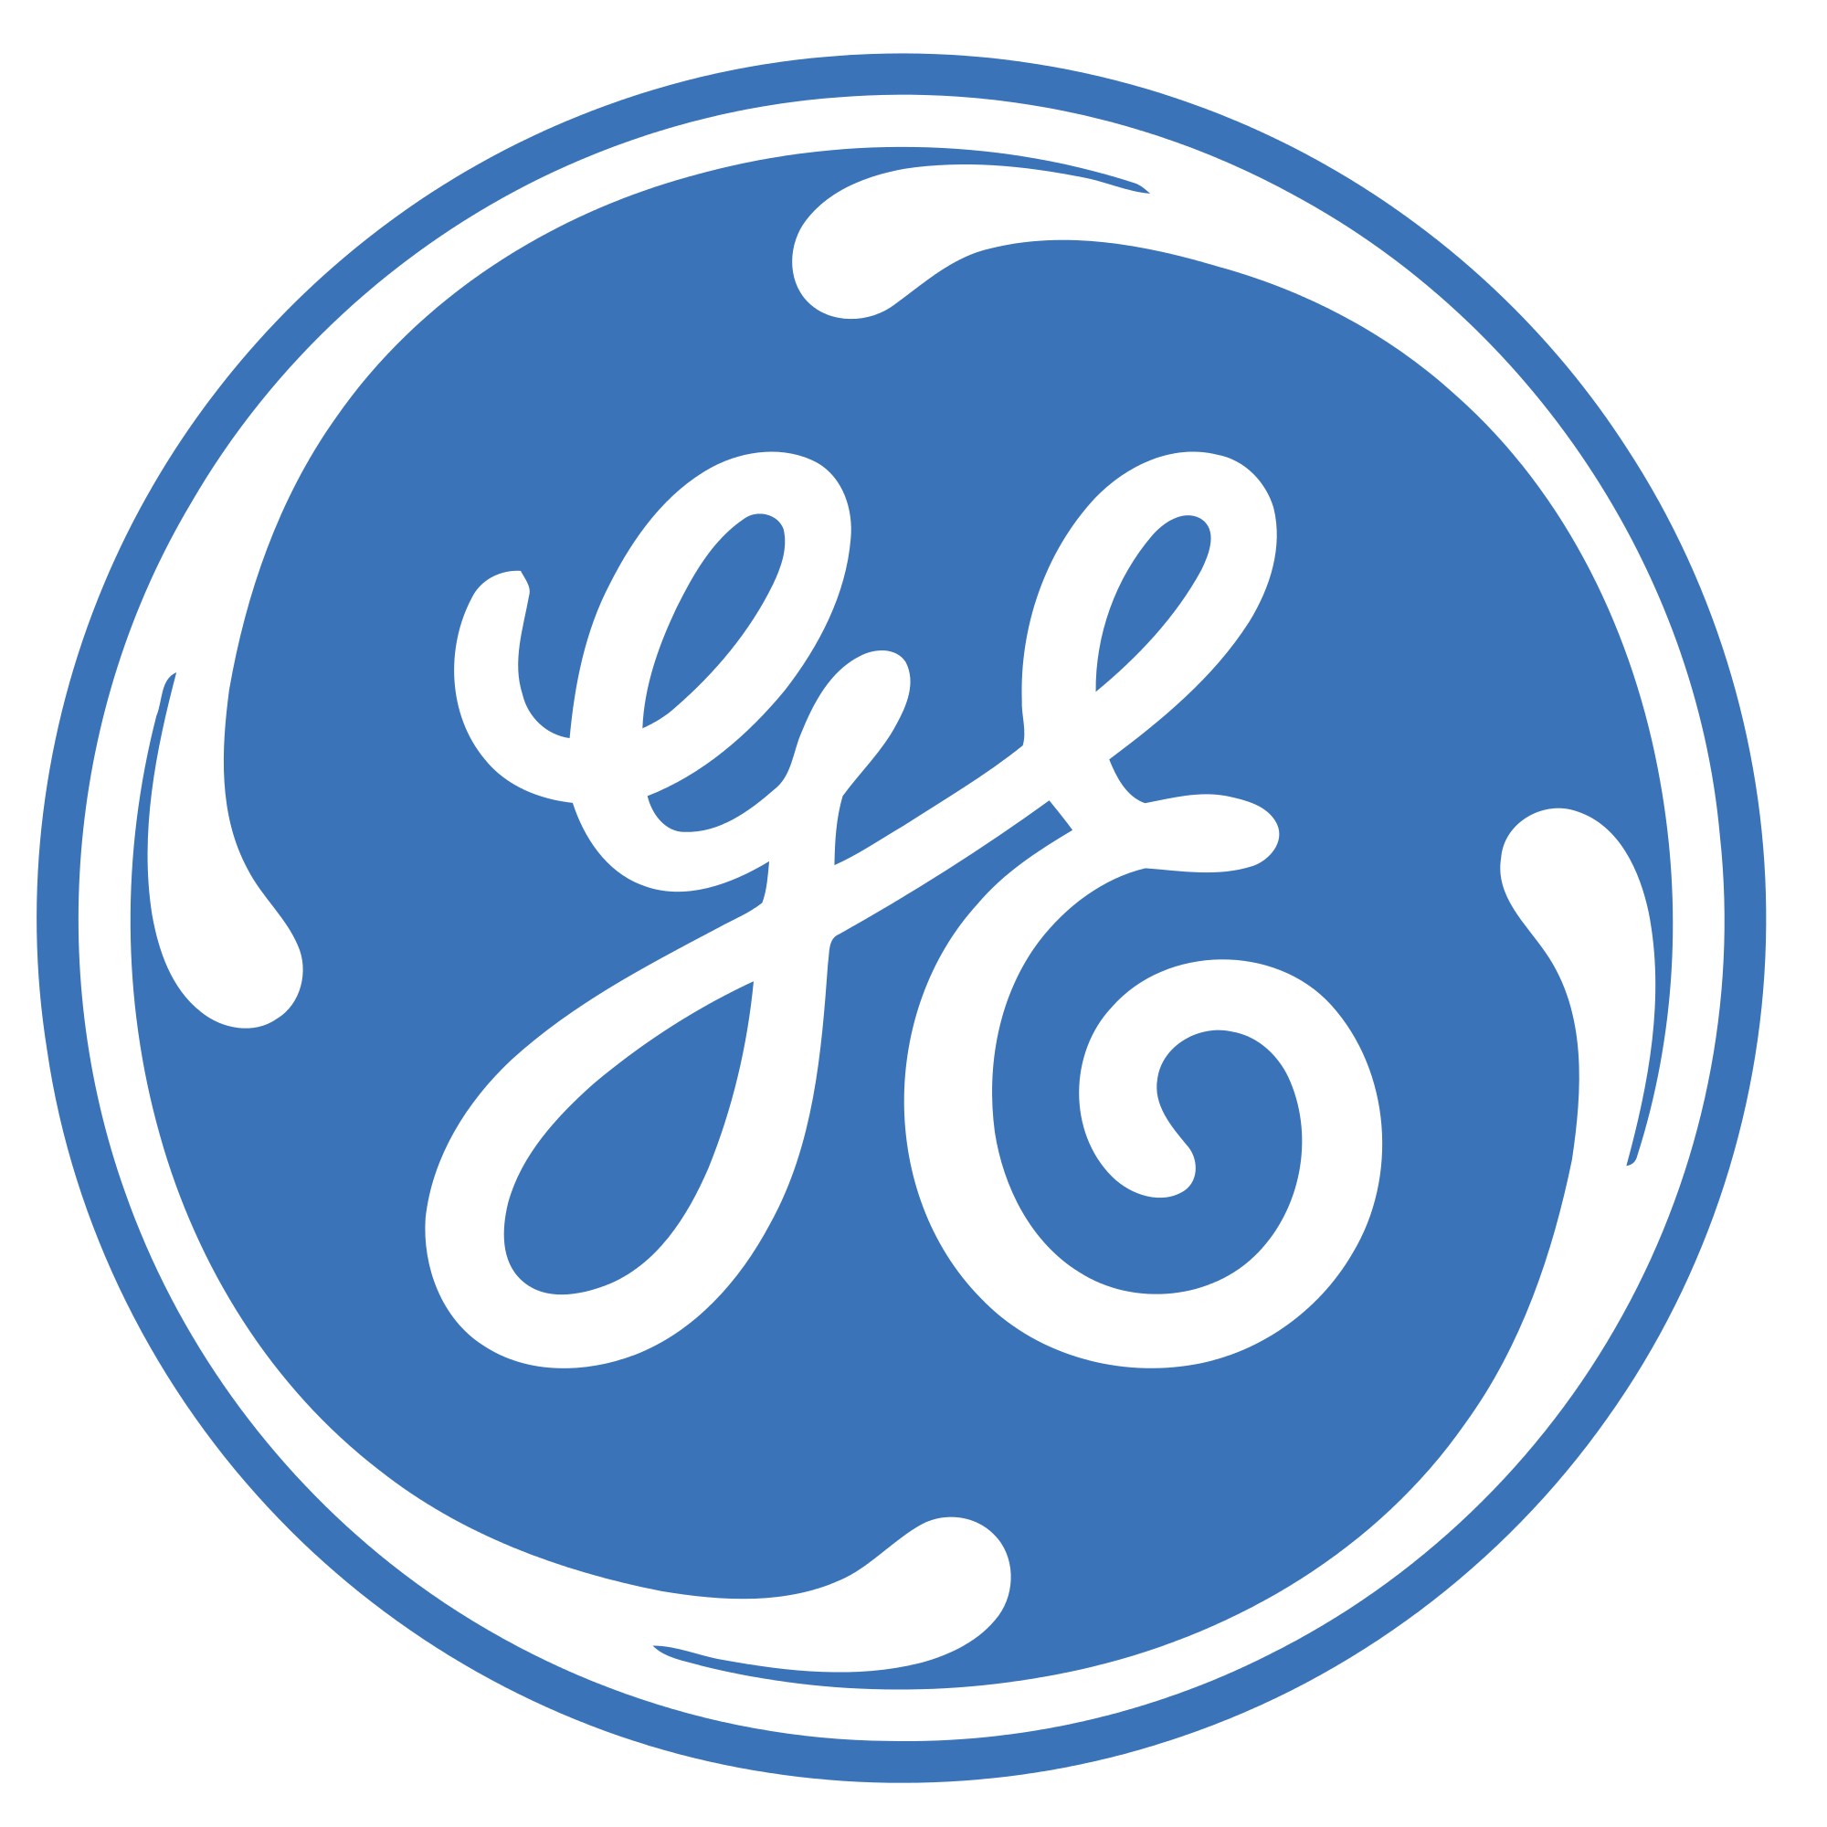
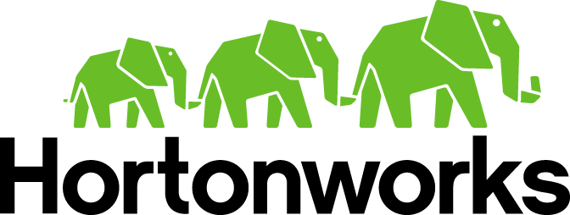
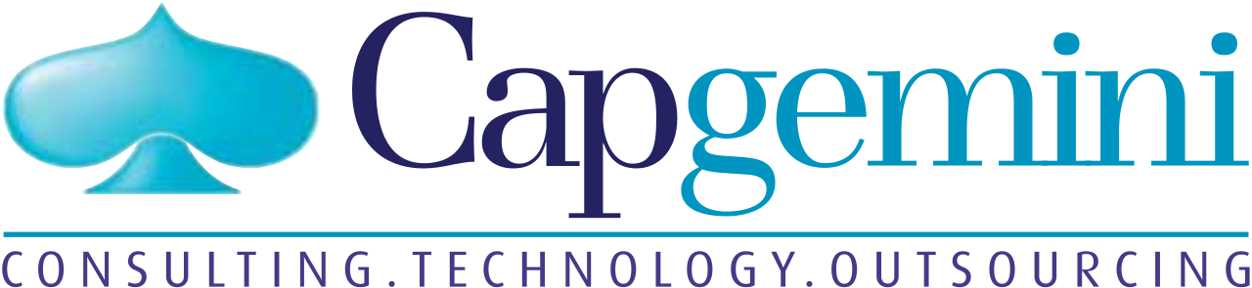
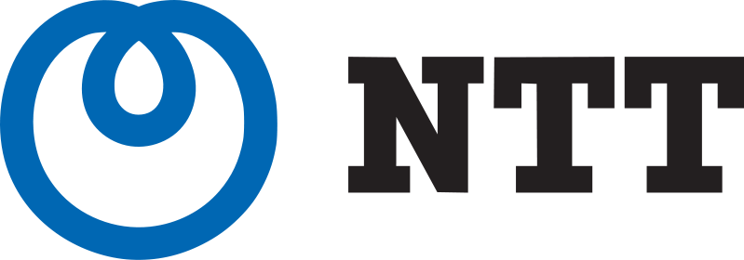




























Cloud Foundry: The Industry’s Open Cloud Standard
PLATINUM
GOLD
SILVER

Slide 63

Lattice.cf

Slide 64
Cloud Foundry & OSS
Notes:
Like every developer knows about agile, but there’re only few really can do it. Cloud Native seems easy, but it contains many of software technologies and operation overheads. To dealing with this truth, Pivotal offers Cloud Foundry for enterprise who wants to archive time-to-market.

Slide 65
외부 서비스 연동 (on-prem example)
Synchronous
Synchronous
Service Broker
Service
Connector
Service
Connector
Service Broker Gateway
Service Broker
IBM DB2
ORACLE DB
Synchronous
Alt Broker
CF MySQL
INTERNET
AppDirect
MYSQL DB
LB
Mongo Lab
Send Grid
ClearDB

Slide 66









Pivotal 이 기여하고 있는 대표적인 오픈소스 프로젝트
더 많은 리스트는 아래의 링크에서 확인 하실 수 있습니다.
http://pivotal.io/oss

Slide 67
Pivotal Open Source Support
Type | Premium Support | Developer Support
Description | Global, 24x7 support for Severity 1 issues | Pivotal Developer Support provides you with assistance during the development phase of applications.
Hours available | 24 Hours / Day 7 Days / Week 365 Days / Year | 12 Business hours / day Local time – Mon to Fri
Length of Service | One or Three years | One or Three years
SLA terms: Target response times | Critical (Severity 1) – 30 mins Major (Severity 2) – 2 Business hours Minor – 8 Business hours | All Severities Standard: 12 Business Hours
For more details : http://pivotal.io/support/oss

Slide 68

















Pivotal Cloud Foundry 와 연동하고 있는 서비스
MySQL
Gemfire
Pivotal
Hadoop
Pivotal
Tracker
Push
Notification
RabbitMQ
RiakCS
Redis
Spring
Cloud
SpringXD
DataStax
CloudBees
Jenkins
PostgreSQL
SQL Fire
Mobile
Suite
Gemfire
HAWQ
http://network.pivotal.io

Slide 69

Pivotal Cloud Foundry Marketplaces
Pivotal Provided Services
OSS Services
$ cf marketplace
3rd Party Services
Public Cloud Services

Slide 70

Example – PWS Marketplace

Slide 71

Example – PWS Marketplace CLI

Slide 72
Example – PWS Marketplace CLI
Service
Service offering

Slide 73
Creating and Binding a Service
Developer
Service
credentials
DB
CLI
create service (HTTP)
Cloud Controller
create service (HTTP)
Service
Broker
reserve resources
Data
Service
Router
bind service (HTTP)
bind service (HTTP)
obtain connection data
Cloud Foundry
Runtime (PaaS)
Notes:
Cloud Foundry PaaS
An application runs in a DEA, which is a droplet execution agent. The Cloud Controller orchestrates the routing and lifecycle of all DEAs in the pool. Routers manage application traffic. Health Manager reports mismatched application states to the CC. A service gateway provides an interface for services (native or external). A messaging bus manages all system communication. Apps are accessed directly through the router while web and CLI clients (e.g., vmc, STS) access Cloud Controller via RESTful services.

Slide 74



Slide 75
Tools
Notes:
Like every developer knows about agile, but there’re only few really can do it. Cloud Native seems easy, but it contains many of software technologies and operation overheads. To dealing with this truth, Pivotal offers Cloud Foundry for enterprise who wants to archive time-to-market.

Slide 76

Pivotal Tracker
http://pirovtaltracker.com
^{Gathering}
^{requirements}
^{Acceptance}
^{Story}
^{Breakdown}
^{Build}
^{Software}
^{Story}
^{Estimation}
^{Priotization}
Click link image to intro video

Slide 77


IDE

Slide 78

Concourse: CI that scales with your project
http://concourse.ci/

Slide 79
Customer Cases
Notes:
Like every developer knows about agile, but there’re only few really can do it. Cloud Native seems easy, but it contains many of software technologies and operation overheads. To dealing with this truth, Pivotal offers Cloud Foundry for enterprise who wants to archive time-to-market.

Slide 80


























































Pivotal Labs 고객사

Slide 81

Why wait? Try it now!
http://projects.spring.io/spring-cloud/

Slide 82

Why wait? Try it now!
http://run.pivotal.io

